Slide 1

Background on GSM Networks
GSM is a 2G digital cellular network
Replaced AMPS analog network ~1991
Initially offered only Circuit Switched voice and SMS
Packet Switching was added via GPRS ~2001
Utilizes Time Division Multiple Access (TDMA) multiplexing

Slide 2
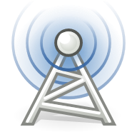
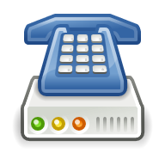
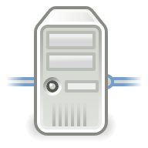
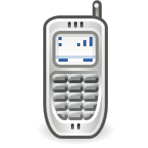
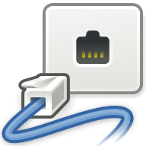
GSM Infrastructure
Minimum System Hardware Required:
User Equipment (UE)
Base Station Controller (BSC)
Master System Controller (MSC)
Home Location Register (HLR)
Base Transceiver Station (BTS)
Access Network
Circuit Switched Core Network

Slide 3
Radio Access Network Details
Each BTS contains some fixed number of Transmit and Receive (TRX) channels
Each is configured for a specific ARFCN (Absolute Radio Frequency Channel Number)
4 Common frequency bands
GSM 900 (Europe, Asia, Middle East)
GSM 850 (Americas)
DCS 1800 (Europe, Asia, Middle East)
PCS 1900 (Americas)

Slide 4
Radio Access Network Details
Each TRX module offers one Downlink & Uplink
Frequency offset between them depends on band
200 KHz channel bandwidth
TDMA provides 8 full-rate time slots per frame
Possibility of 16 half-rate
Minimum of 1-2 slots required for control signaling
Exact frame configuration up to carrier
CCH
CCH
FR-TCH
FR-TCH
FR-TCH
FR-TCH
FR-TCH
FR-TCH

Slide 5
Radio Access Network Details
Consequence of TDMA frame size is limited maximum users
Depending on configuration, maximum of 12-14
Once all slots on a TRX are taken, no new calls can be established
Most BTSs/Base Stations offer many TRXs to reduce conflict
Frequency deconfliction is necessary
CCH
CCH
User 1
User 2
User 3
User 4
User 5
User 6
User 7
User 8
User 9
User 10
User 11
User 12
User 13

